Slide 1
Memory Hierarchy (Ⅳ)

Slide 2
Outline
Write cache friendly codes
Matrix multiplication
Memory mountain
Suggested Reading: 6.5, 6.6

Slide 3
Writing Cache-Friendly Code
Principles
  Programs with better locality will tend to have lower miss rates
  Programs with lower miss rates will tend to run faster than programs with higher miss rates

Slide 4
Writing Cache-Friendly Code
Basic approach
  Make the common case go fast
    Programs often spend most of their time in a few core functions.
    These functions often spend most of their time in a few loops
  Minimize the number of cache misses in each inner loop
    All things being equal

Slide 5
Writing Cache-Friendly Code
(pp. 650)
int sumvec(int v[N])
{
int i, sum = 0 ;
for (i = 0 ; i < N ; i++)
sum += v[i] ;
return sum ;
}
Temporal locality,
These variables are usually put in registers
v[i]
i=0
i= 1
i= 2
i= 3
i= 4
i= 5
i= 6
i= 7
Access order,
[h]it or [m]iss
1[m]
2[h]
3[h]
4[h]
5[m]
6[h]
7[h]
8[h]

Slide 6
Writing cache-friendly code
Temporal locality
  Repeated references to local variables are good because the compiler can cache them in the register file

Slide 7
Writing cache-friendly code
Spatial locality
  Stride-1 references patterns are good because caches at all levels of the memory hierarchy store data as contiguous blocks
Spatial locality is especially important in programs that operate on multidimensional arrays

Slide 8
Writing cache-friendly code
Example (pp. 651, M=4, N=8)
int sumarrayrows(int a[M][N])
{
int i, j, sum = 0 ;
for (i = 0 ; i < M ; i++)
for ( j = 0 ; j < N ; j++ )
sum += a[i][j] ;
return sum ;
}

Slide 9
Writing cache-friendly code
a[i][j] | j=0 | j= 1 | j= 2 | j= 3 | j= 4 | j= 5 | j= 6 | j= 7
i=0 i=1 i=2 i=3 | 1[m] 9[m] 17[m] 25[m] | 2[h] 10[h] 18[h] 26[h] | 3[h] 11[h] 19[h] 27[h] | 4[h] 12[h] 20[h] 28[h] | 5[m] 13[m] 21[m] 29[m] | 6[h] 14[h] 22[h] 30[h] | 7[h] 15[h] 23[h] 31[h] | 8[h] 16[h] 24[h] 32[h]

Slide 10
Writing cache-friendly code
Example (pp. 651, M=4, N=8)
int sumarraycols(int a[M][N])
{
int i, j, sum = 0 ;
for ( j = 0 ; j < N ; j++ )
for ( i = 0 ; i < M ; i++ )
sum += a[i][j] ;
return sum ;
}

Slide 11
Writing cache-friendly code
a[i][j] | j=0 | j= 1 | j= 2 | j= 3 | j= 4 | j= 5 | j= 6 | j= 7
i=0 i=1 i=2 i=3 | 1[m] 2[m] 3[m] 4[m] | 5[m] 6[m] 7[m] 8[m] | 9[m] 10[m] 11[m] 12[m] | 13[m] 14[m] 15[m] 16[m] | 17[m] 18[m] 19[m] 20[m] | 21[m] 22[m] 23[m] 24[m] | 25[m] 26[m] 27[m] 28[m] | 29[m] 30[m] 31[m] 32[m]

Slide 12
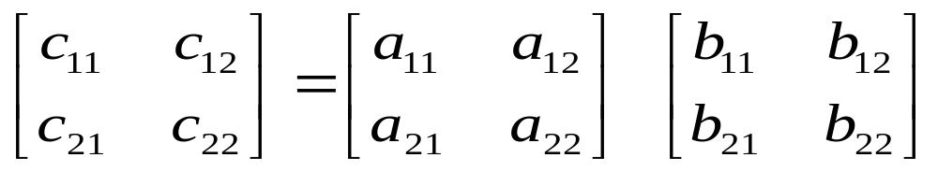
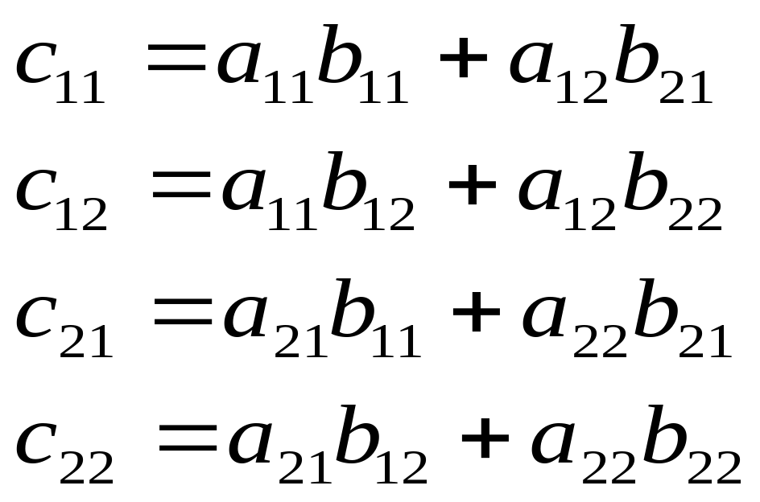
Matrix Multiplication

Slide 13
Matrix Multiplication Implementation
/* ijk */
for (i=0; i<n; i++) {
for (j=0; j<n; j++) {
c[i][j] = 0.0;
for (k=0; k<n; k++)
c[i][j] += a[i][k] * b[k][j];
}
}
O(n³)adds and multiplies
Each n² elements of A and B is read n times

Slide 14
Matrix Multiplication
Assumptions:
  Each array is an n×n array of double, with size 8
  There is a single cache with a 32-byte block size ( B=32 )
  The array size n is so large that a single matrix row does not fit in the L1 cache
  The compiler stores local variables in registers, and thus references to local variables inside loops do not require any load and store instructions.

Slide 15
Matrix Multiplication
/* ijk */
for (i=0; i<n; i++) {
for (j=0; j<n; j++) {
sum = 0.0;
for (k=0; k<n; k++)
sum += a[i][k] * b[k][j];
c[i][j] = sum;
}
}
Variable sum
held in register

Slide 16
Matrix multiplication (ijk)
/* ijk */
for (i=0; i<n; i++) {
for (j=0; j<n; j++) {
sum = 0.0;
for (k=0; k<n; k++)
sum += a[i][k] * b[k][j];
c[i][j] = sum;
}
}
Inner loop:
(*,j)
(i,j)
(i,*)
A
B
C
Row-wise
Column-wise
Fixed
Misses per Inner Loop Iteration:
  A B C
  0.25 1.0 0.0
  2 loads, 0 stores
  misses/iter = 1.25

Slide 17
Matrix multiplication (jik)
/* jik */
for (j=0; j<n; j++) {
for (i=0; i<n; i++) {
sum = 0.0;
for (k=0; k<n; k++)
sum += a[i][k] * b[k][j];
c[i][j] = sum;
}
}
Inner loop:
(*,j)
(i,j)
(i,*)
A
B
C
Row-wise
Column-wise
Fixed
Misses per Inner Loop Iteration:
  A B C
  0.25 1.0 0.0
  2 loads, 0 stores
  misses/iter = 1.25

Slide 18
Matrix multiplication (kij)
/* kij */
for (k=0; k<n; k++) {
for (i=0; i<n; i++) {
r = a[i][k];
for (j=0; j<n; j++)
c[i][j] += r * b[k][j];
}
}
Inner loop:
(i,k)
(k,*)
(i,*)
A
B
C
Fixed
Row-wise
Row-wise
Misses per Inner Loop Iteration:
  A B C
  0.0 0.25 0.25
  2 loads, 1 store
  misses/iter = 0.5

Slide 19
Matrix multiplication (ikj)
/* ikj */
for (i=0; i<n; i++) {
for (k=0; k<n; k++) {
r = a[i][k];
for (j=0; j<n; j++)
c[i][j] += r * b[k][j];
}
}
Inner loop:
(i,k)
(k,*)
(i,*)
A
B
C
Fixed
Row-wise
Row-wise
Misses per Inner Loop Iteration:
  A B C
  0.0 0.25 0.25
  2 loads, 1 store
  misses/iter = 0.5

Slide 20
Matrix multiplication (ikj)
/* ikj */
for (i=0; i<n; i++) {
for (k=0; k<n; k++) {
r = a[i][k];
for (j=0; j<n; j++)
c[i][j] += r * b[k][j];
}
}
Inner loop:
(i,k)
(k,*)
(i,*)
A
B
C
Fixed
Row-wise
Row-wise
Misses per Inner Loop Iteration:
  A B C
  0.0 0.25 0.25
  2 loads, 1 store
  misses/iter = 2.0

Slide 21
Matrix multiplication (jki)
/* jki */
for (j=0; j<n; j++) {
for (k=0; k<n; k++) {
r = b[k][j];
for (i=0; i<n; i++)
c[i][j] += a[i][k] * r;
}
}
Inner loop:
(*,k)
(*,j)
(k,j)
A
B
C
Column -wise
Fixed
Column-wise
Misses per Inner Loop Iteration:
  A B C
  1.0 0.0 1.0
  2 loads, 1 store
  misses/iter = 2.0

Slide 22
Matrix multiplication (kji)
/* kji */
for (k=0; k<n; k++) {
for (j=0; j<n; j++) {
r = b[k][j];
for (i=0; i<n; i++)
c[i][j] += a[i][k] * r;
}
}
Inner loop:
(*,k)
(*,j)
(k,j)
A
B
C
Column -wise
Fixed
Column-wise
Misses per Inner Loop Iteration:
  A B C
  1.0 0.0 1.0
  2 loads, 1 store
  misses/iter = 2.0

Slide 23
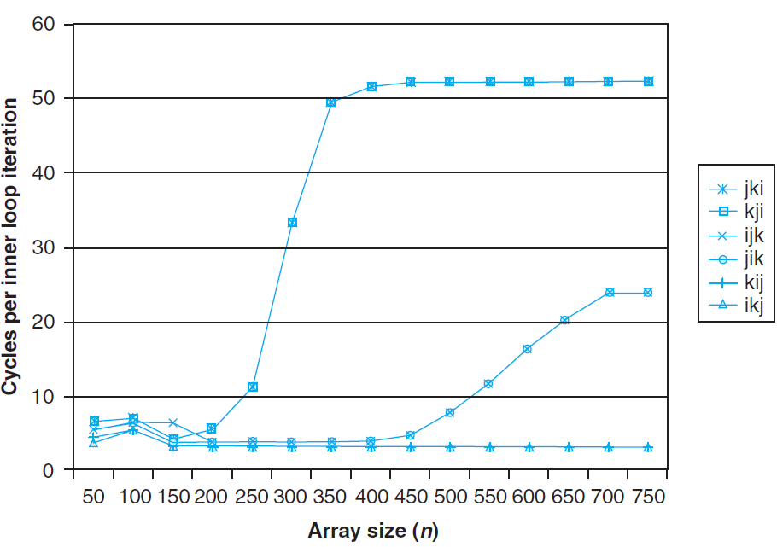
Pentium matrix multiply performance

Slide 24
Pentium matrix multiply performance
The performance difference is
  almost 20 times for the same application
Pairs of versions have almost identical measured performance
  with the same number of memory references and misses per
The worst memory behavior versions run significantly slower than the other versions
  in terms of the number of accesses and misses per iteration

Slide 25
Pentium matrix multiply performance
Miss rate, in this case, is a better predictor of performance than the total number of memory accesses.
The performance of the fastest pair of versions (kij and ikj) is constant
  the array is much larger than any of the cache
the prefetching hardware is
  smart enough to recognize the stride-1 access
  fast enough to keep up with memory accesses in the tight inner loop

Slide 26
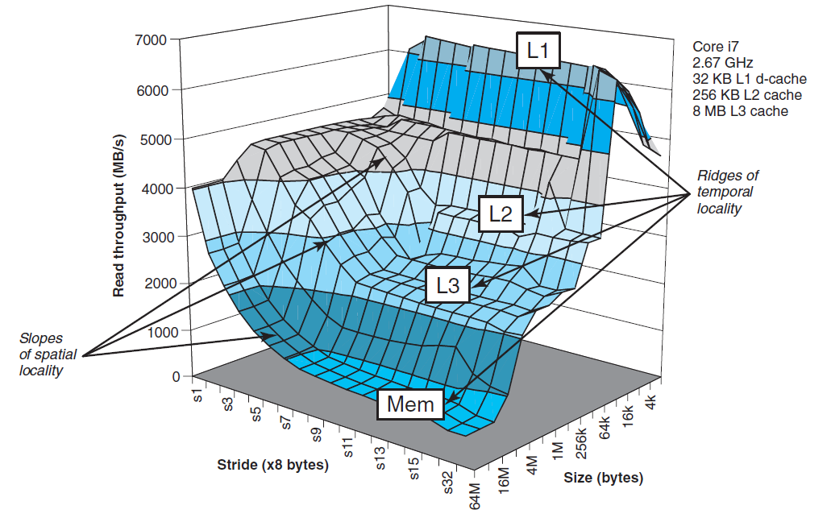
The Memory Mountain

Slide 27
The Memory Mountain
Read throughput (read bandwidth)
  The rate that a program reads data from the memory system
Memory mountain
  A two-dimensional function of read bandwidth versus temporal and spatial locality
  Characterizes the capabilities of the memory system for each computer

Slide 28
Memory mountain main routine
/* mountain.c - Generate the memory mountain. */
#define MINBYTES (1 << 11) /* Working set size ranges from 2 KB */
#define MAXBYTES (1 << 26) /* ... up to 64 MB */
#define MAXSTRIDE 64 /* Strides range from 1 to 64 */
#define MAXELEMS MAXBYTES/sizeof(data)
double data[MAXELEMS]; /* The array we'll be traversing */

Slide 29
Memory mountain main routine
int main()
{
int size; /* Working set size (in bytes) */
int stride; /* Stride (in array elements) */
double Mhz; /* Clock frequency */
init_data(data, MAXELEMS); /* Initialize each element in data to 1 */
Mhz = mhz(0); /* Estimate the clock frequency */

Slide 30
Memory mountain main routine
for (size = MAXBYTES; size >= MINBYTES; size >>= 1) {
for (stride = 1; stride <= MAXSTRIDE; stride++)
printf("%.1f\t", run(size, stride, Mhz));
printf("\n");
}
exit(0);
}

Slide 31
Memory mountain test function
/* The test function */
void test (int elems, int stride) {
int i ;
double result = 0.0 ;
volatile double sink;
for (i = 0; i < elems; i += stride)
result += data[i];
sink = result; /* So compiler doesn't optimize away the loop */
}

Slide 32
Memory mountain test function
/* Run test (elems, stride) and return read throughput (MB/s) */
double run (int size, int stride, double Mhz)
{
double cycles;
int elems = size / sizeof(double);
test (elems, stride); /* warm up the cache */
cycles = fcyc2(test, elems, stride, 0); /* call test (elems,stride) */
return (size / stride) / (cycles / Mhz); /* convert cycles to MB/s */
}

Slide 33
The Memory Mountain
Data
  Size
    MAXBYTES(64M) bytes or MAXELEMS(8M) doubles
  Partially accessed
    Working set: from 64MB to 2KB
    Stride: from 1 to 64

Slide 34
The Memory Mountain

Slide 35
Ridges of temporal locality
Slice through the memory mountain with stride=16
  illuminates read throughputs of different caches and memory

Slide 36
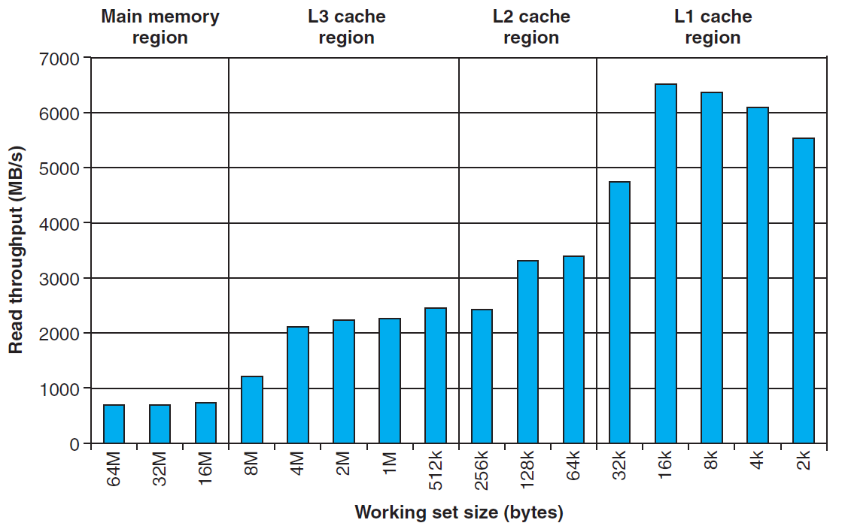
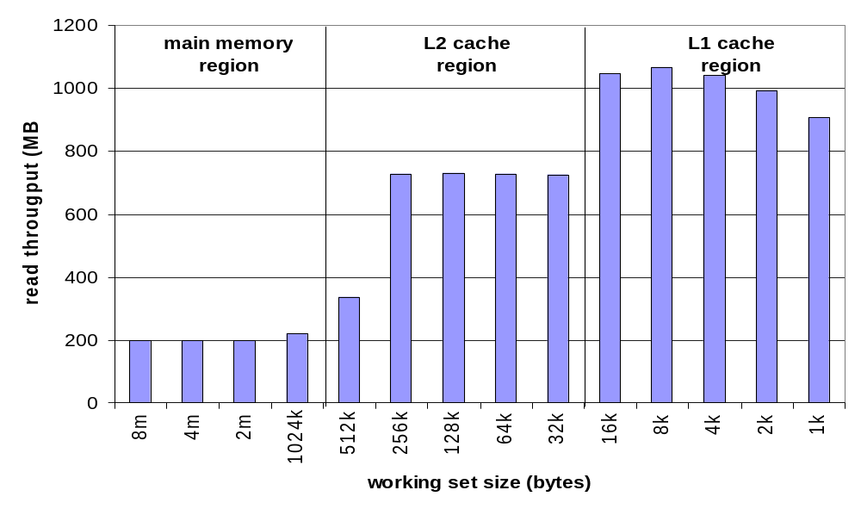
Ridges of temporal locality

Slide 37
A slope of spatial locality
Slice through memory mountain with size=4M
  shows cache block size.

Slide 38
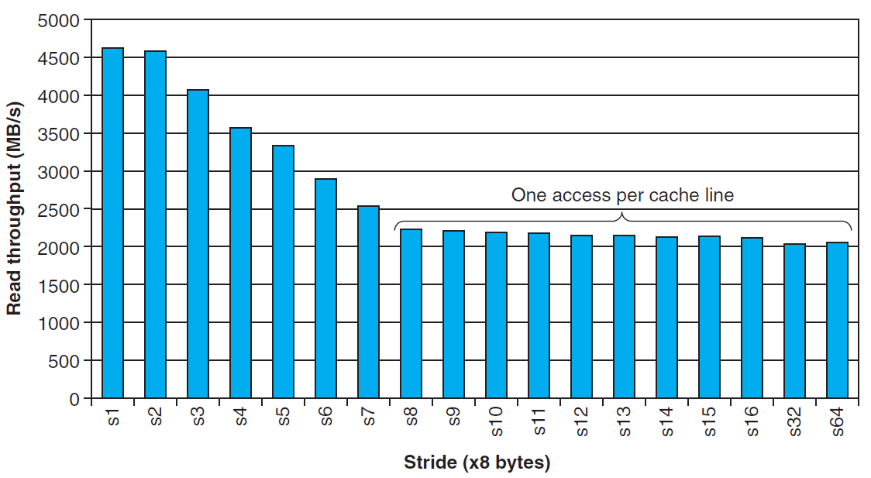
A slope of spatial locality

